Slide 1
Proteome-wide Screen for RNA-dependent Proteins
non-synchronized A549 cells
DataScience SS21 - Project 3 Group 4
Izar Schärf, Lukas link, Alexandra Kummer, Celina Schenkelberger

Slide 2
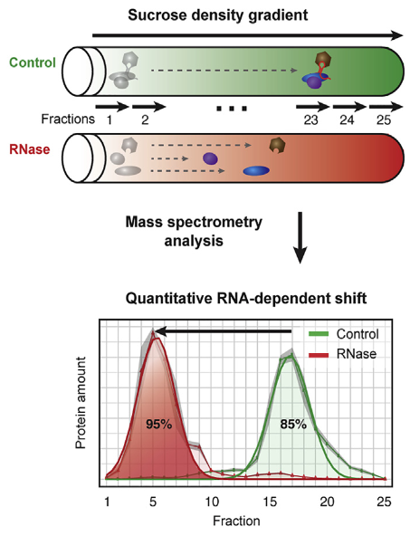
R-DeeP: Proteome-wide Screen for RNA-dependent Proteins
RNA-binding proteins (RBPs) play key regulatory roles in various central cellular processes: RNA biogenesis, regulation of gene expression, alternative splicing, …
malfunction of RBPs is origin of many diseases ranging from neurodegenerative disorders to cancer
R-DeeP : proteome-wide, unbiased, and enrichment-free screen, based on density gradient ultracentrifugation
defining a protein as RNA dependent when its interactome depends on RNA
RBPs are expected to migrate to different positions in a sucrose density gradient in the presence or absence of RNA
non-synchronized A549 cells:

Slide 3
Project goals
End goal is to perform analysis of the mass spectrometry data to automatically identify RNA-dependent proteins
Literature:
Normalization and cleanup
Identification of maxima
Clustering/ shift detection
Definition/Application of selection criteria
Further analysis and evaluation

Slide 4
Dataset
raw massspectrometry data from non-synchronized A549 cells
25 fractions
3 repetitions
3680 human proteins
Human protein | Fraction 1 Rep. 1 Ctlr | Fraction 1 Rep. 1 RNase | Fraction 1 Rep. 2 Ctlr | Fraction 1 Rep. 2 RNase | Fraction 1 Rep. 3 Ctlr | Fraction 1 Rep. 3 RNase | Fraction 2 Rep. 1 Ctlr | … Fraction 25
PTPRJ_HUMAN | 0 | 0 | 0 | 0
B2L13_HUMAN | 76 | 88
Klasse 3 | 84 | 90

Slide 5
Milestone 1: Normalization and cleanup
Delivers:
Planned analysis steps:

Slide 6
Milestone 2: Identification of maxima
Delivers:
Planned analysis steps:

Slide 7
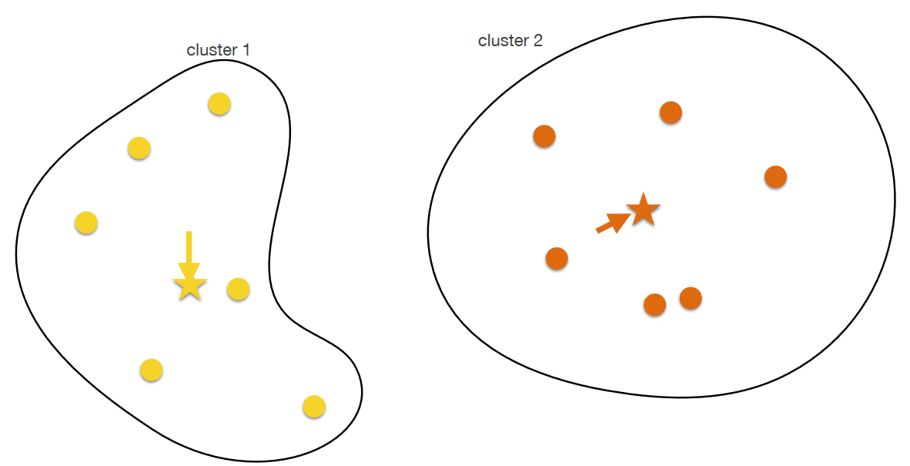
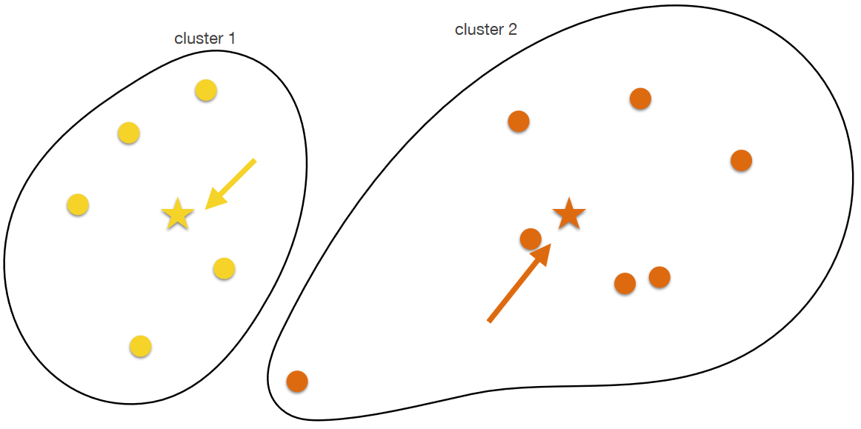
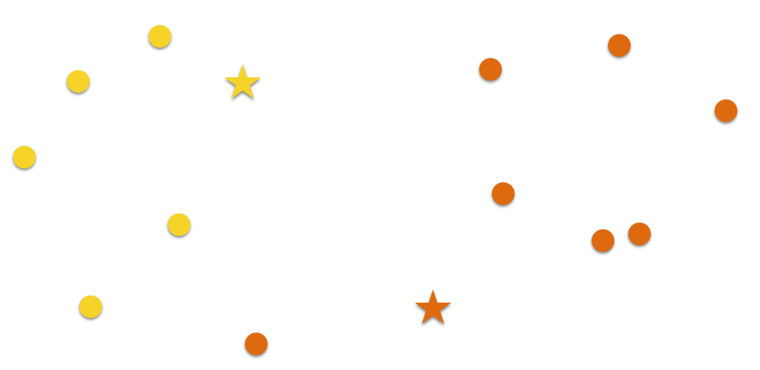
Milestone 3: K-means clustering
Choose k random points as centers
Assign each datapoint to the nearest center → cluster
determine center of gravity
Assign each datapoint to the nearest new center → new cluster
Repeat steps 3. & 4. until:
Predefined maximum number of iterations is reached
No datapoint changed its cluster
Source: Lecture Computer Science Dr. Carl Hermann

Slide 8
Milestone 4: Definition/Application of selection criteria
Delivers:
Planned analysis steps:

Slide 9
Performance evaluation: Dice score
Statistical method to evaluate the similarity of two samples
Compares output with the ‘ground truth’

Slide 10
Timeline
Data cleanup

Slide 11
Timeline
Data cleanup
maxima

Slide 12
Timeline
Data cleanup (Datum)
kjlkjl
kjoj

